Slide 1
SMART RATION SHOP

Slide 2
COMPONENTS
ARUDINO UNO
LCD DISPLAY
RFID READER
SERVO MOTOR
KEYPAD
RFID CARD

Slide 3
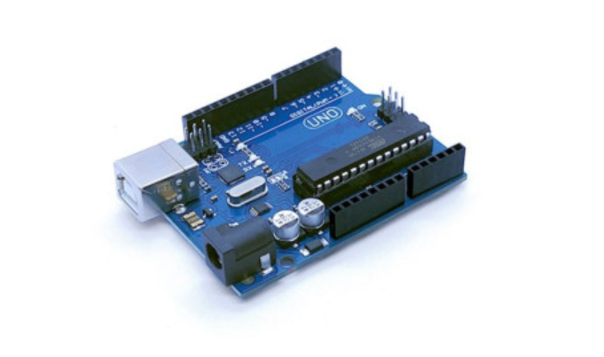
ARUDINO UNO
The Arduino Uno is an open-source microcontroller board based on the Microchip ATmega328P microcontroller and developed by Arduino.cc. The board is equipped with sets of digital and analog input/output (I/O) pins that may be interfaced to various expansion boards (shields) and other circuits.[1] The board has 14 digital I/O pins (six capable of PWM output), 6 analog I/O pins, and is programmable with the Arduino IDE (Integrated Development Environment), via a type B USB cable.[4] It can be powered by the USB cable or by an external 9-volt battery, though it accepts voltages between 7 and 20 volts. It is similar to the Arduino Nano and Leonardo . The hardware reference design is distributed under a Creative Commons Attribution Share-Alike 2.5 license and is available on the Arduino website. Layout and production files for some versions of the hardware are also available.

Slide 4
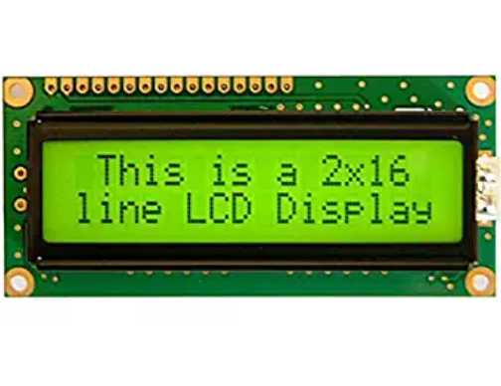
LCD DISPLAY
A liquid-crystal display (LCD) is a flat-panel display or other electronically modulated optical device that uses the light-modulating properties of liquid crystals combined with polarizers. Liquid crystals do not emit light directly, instead using a backlight or reflector to produce images in color or monochrome. LCDs are available to display arbitrary images (as in a general-purpose computer display) or fixed images with low information content, which can be displayed or hidden. For instance: preset words, digits, and seven-segment displays, as in a digital clock, are all good examples of devices with these displays. They use the same basic technology, except that arbitrary images are made from a matrix of small pixels, while other displays have larger elements. LCDs can either be normally on (positive) or off (negative), depending on the polarizer arrangement.

Slide 5
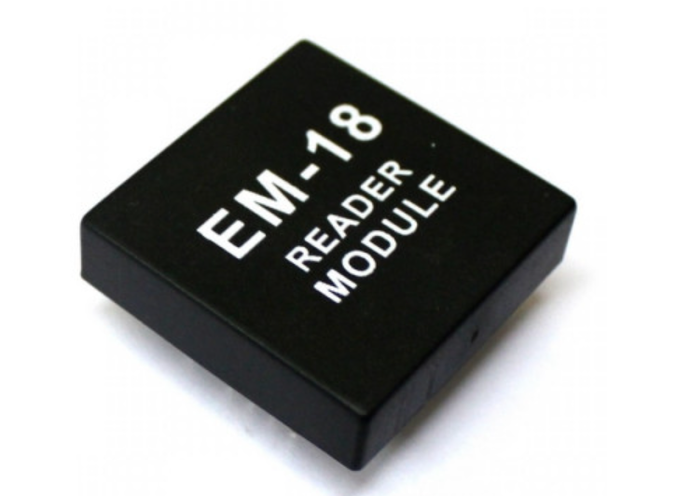
RFID READER
Radio-frequency identification (RFID) uses electromagnetic fields to automatically identify and track tags attached to objects. An RFID system consists of a tiny radio transponder, a radio receiver and transmitter. When triggered by an electromagnetic interrogation pulse from a nearby RFID reader device, the tag transmits digital data, usually an identifying inventory number, back to the reader. This number can be used to track inventory goods.

Slide 6
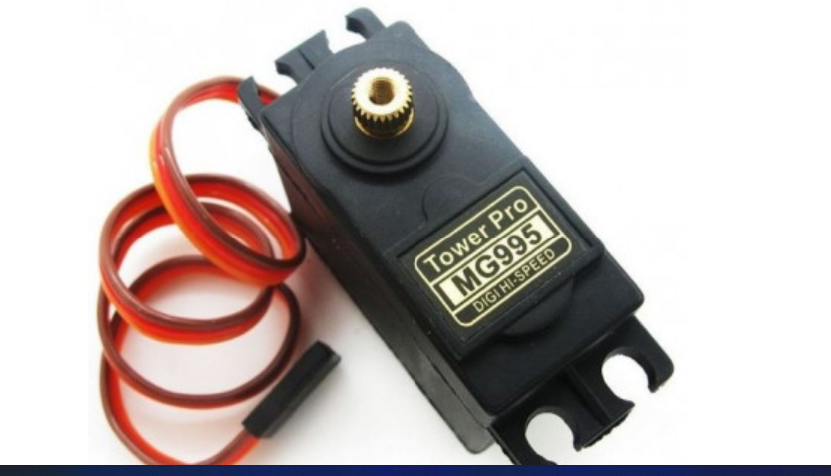
SERvo MOTOR
It is a Digital Servo Motor which receives and processes PWM signal faster and better. It equips sophisticated internal circuitry that provides good torque, holding power, and faster updates in response to external forces.

Slide 7
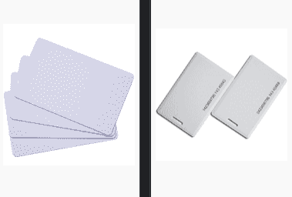
RFID CARD
RFID cards ​​are used for applications where tracking or identifying personnel is important or where access control is required. Various RFID frequency bands are utilized in cards today, including 125 kHz low frequency proximity, 13.56 MHz high frequency smart card and 860-960 MHz ultra-high frequency (UHF).

Slide 8
THANK YOU

